Slide 1

Finding MIMO
Weekly Meeting: Week 6
Kate Bowers, Kristopher Jung, Samuel Spillane

Slide 2
Project Goals
Model receiver-side CEs to determine the best way to decode received signals
Choose equalization algorithm and parameters
Choose channel estimation technique
Optimize parameters for the best Bit Error Rate (BER), Power Gain, or throughput

Slide 3

Progress and challenges
SNR/Sampling Rate play a big role in BER
Need a good assumption.
Matlab equalizers not compatible with OFDM
Working Q-Learning Algorithm
Training one parameter at a time.
Local optimum only.
Inadequate for equalizer param-sets

Slide 4
Progress and challenges Contd.
Working Genetic Algorithm
Often stuck in local optimum
Need to play with rate of mutation, stall generation, number of population, or generations to avoid it.
Focus on faster convergence.
Only utilizing one variable at this time.
Big searching space and complexity still causes troubles for both cognitive algorithms.
Broken computer

Slide 5
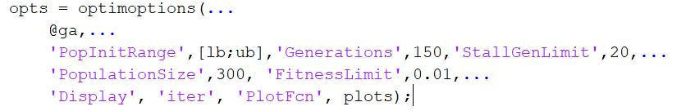
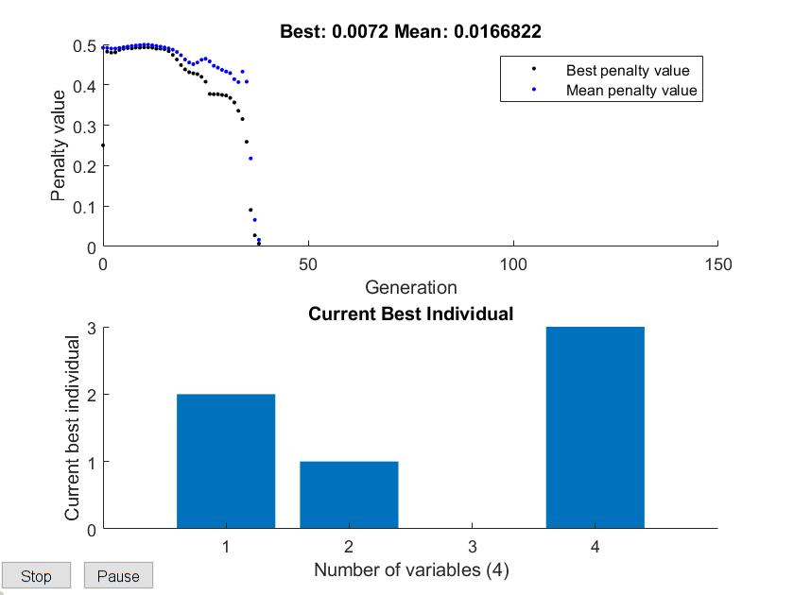
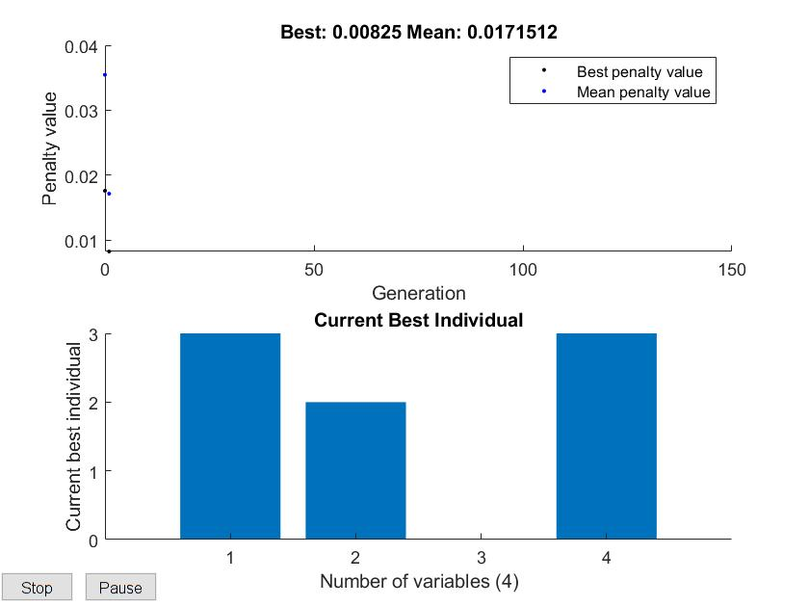
Genetic Algorithm for MIMO
Graphs acquired under the same conditions. (SNR 15/ SR 20e6)

Slide 6
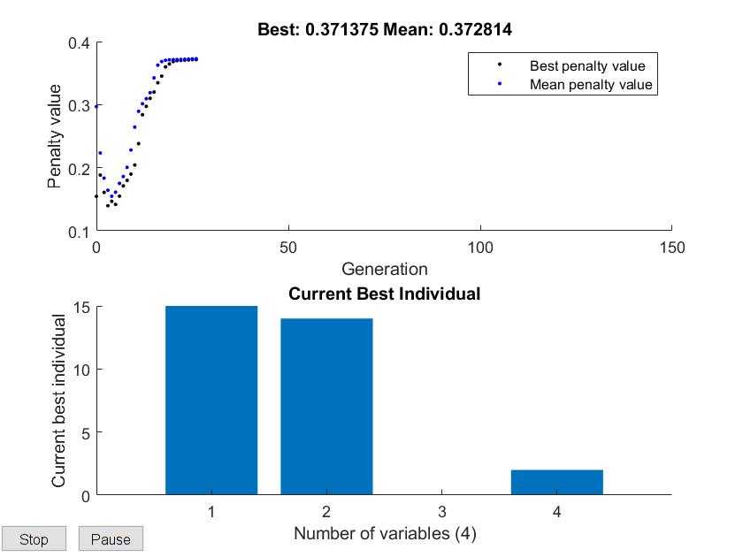
Genetic Algorithm for MIMO
Often stuck in a local optimum, and fails to yield global optimum.Higher the population size, lower chance of stuck in a local optimum.
Convergence time not guaranteed even with the same configuration due to the nature of epsilon greedy.

Slide 7
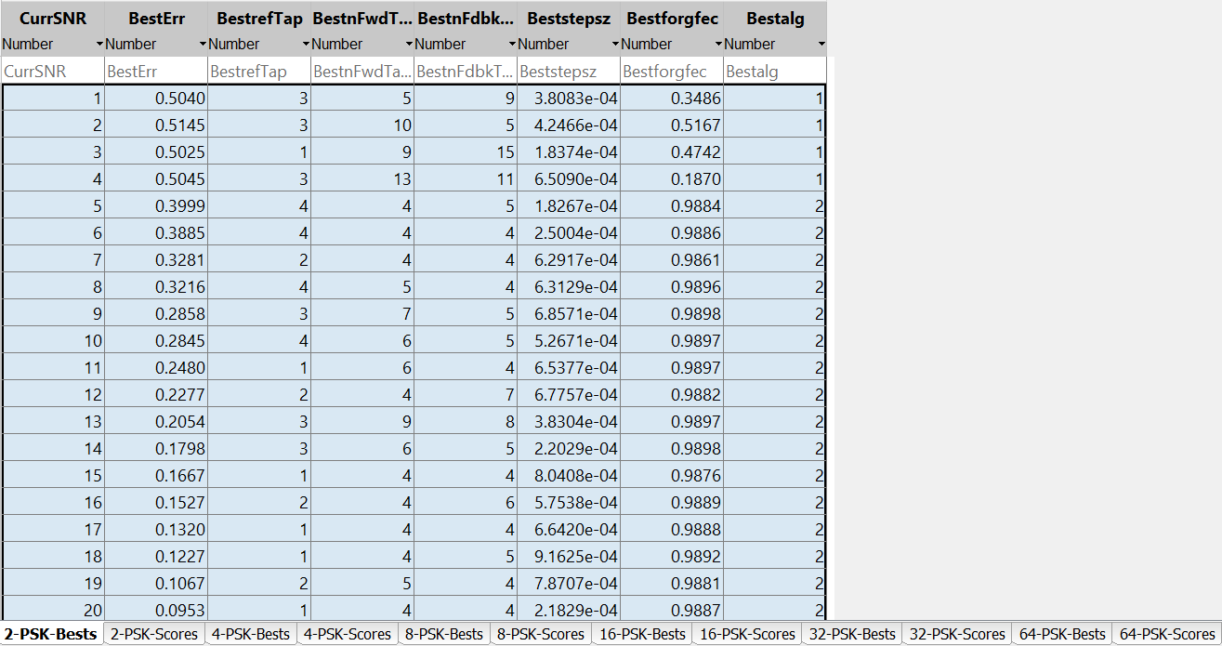
Data acquisition
Accumulating lookup database of trained params in the hope of reducing the searching space and avoid stucking in local optimum.

Slide 8
HF MIMO Baseline Model
Found published data using various techniques
Convolutional Coding
Standard with QPSK
Implemented modular code for easy testing
Need to integrate simple equalizers
Vasily Yu. Doroshenko, Inna O. Dvorakova, Alexander A. Malyutin, and Yuri B. Nechaev "Experimental Study of Cooperative MIMO at HF Band," in Proc. 36th International Conf. on Telecommunications and Signal Processing (TSP), Rome, Italy, 2013, pp 160-165.
R. C. Daniels and S. W. Peters, "A New MIMO HF Data Link: Designing for High Data Rates and Backwards Compatibility," MILCOM 2013 - 2013 IEEE Military Communications Conference, San Diego, CA, 2013, pp. 1256-1261.
O. C. Oghre and S. Salous, "BER performance evaluation of HF MIMO spatial multiplexing systems," 2014 XXXIth URSI General Assembly and Scientific Symposium (URSI GASS), Beijing, 2014, pp. 1-2.

Slide 9
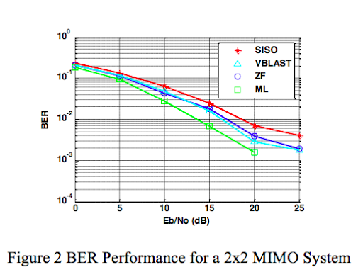
From Oghre and Salous.

Slide 10
What Was Wrong?
Last week, we were told that our BER was concerningly high
Appears to be a difference in MATLAB implementations of AWGN
Built-in AWGN
Communications Toolbox AWGN object

Slide 11
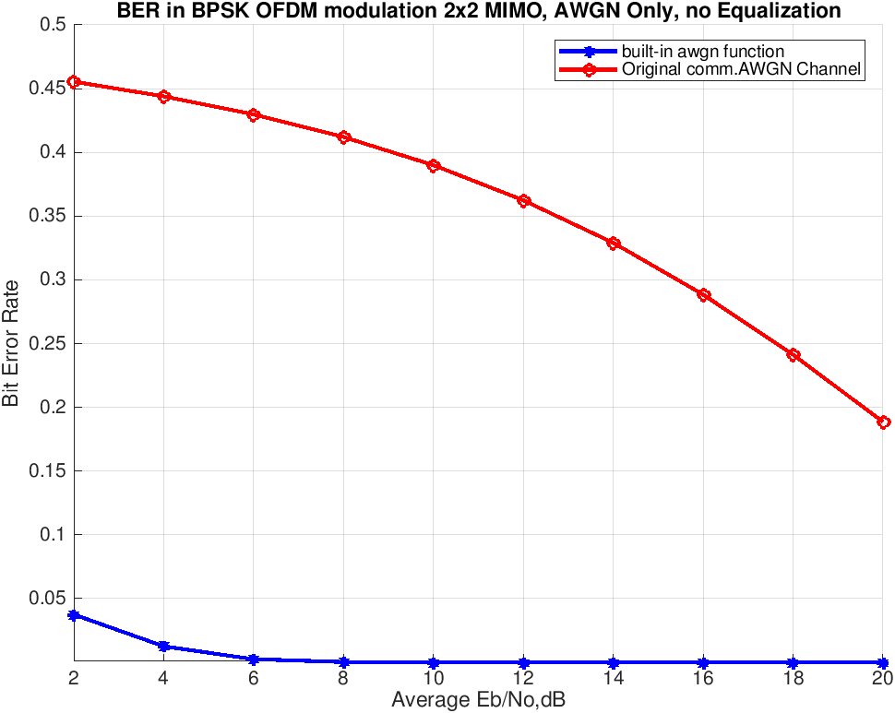
Conclusion: use the built-in function

Slide 12
Q-Learning
Q-Learning function is working for variables independent of one another and finds local optimums of each variable.
Currently adapting function to work with with multiple variables in conjunction with one another to find plural optimum.
Programming a new methodology to handle multiple variable without using a n-dimensional Q-Table using an n-ordered counting system and a hash table to calculate rewards to achieve n^2 space requirements in n lookup-time.

Slide 13
Roadmap
Week 6
Invent modification of Q-Learning Algorithm for multiple variables in conjunction.
Determine parameters for CEs, determine testing conditions
Finish integrating equalizers with baseline model
Weeks 7
Work on producing data and derive novel and meaningful conclusion
Optimization
Week 8-10
Other tasks
paper writing

Slide 14
Questions?

